Slide 1
Automatic evaluation of liver cirrhosis in lung cancer patients
Gabriel Battcock
with lab partner Theo Cohen
MPhys final project

Slide 2
Introduction
Aim to study if liver damage affects the treatment of lung cancer.
To do so, large cohorts of patients’ data needs to be evaluated without extensive human input.
Therefore, an automatic system to evaluate the level of fibrosis and cirrhosis in the liver is needed.

Slide 3
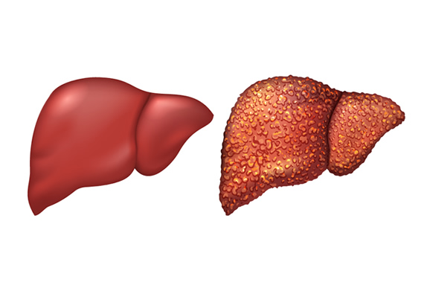
Liver cirrhosis
[1] https://www.gastroconsa.com/patient-education/liver-cirrhosis/
The liver is an important organ for the immune system. Damage to the liver may impede treatment for lung cancer using radiotherapy.
Build-up of scar tissue causes the liver to become fibrotic and appear wrinkled on its surface.
The wrinkled surface appears on the CT scan slices as rough nodules.
By comparing how wrinkled the surface is to the smooth surface of a supposed healthy liver, a biomarker for cirrhosis can be obtained.

Slide 4
Outline of project
To create a fully automated system, we identified three key steps:
Identifying the liver from a full CT scan
Automatically segment the liver using a pre-trained neural network
Use an evaluation method called the liver surface nodularity (LSN) score to assess level of fibrosis (level 4 fibrosis being cirrhosis)

Slide 5
Identifying the liver from full CT scan
The programme needs to be able to find a section of the liver to evaluate from the input of a full CT scan
Two methods were tried:
Finding the liver using the maximum mean pixel value of each slice, as the liver appears bright and large respective to other tissue in the body.
Using connected components to find the bottom of the lung and the liver below it.

Slide 6
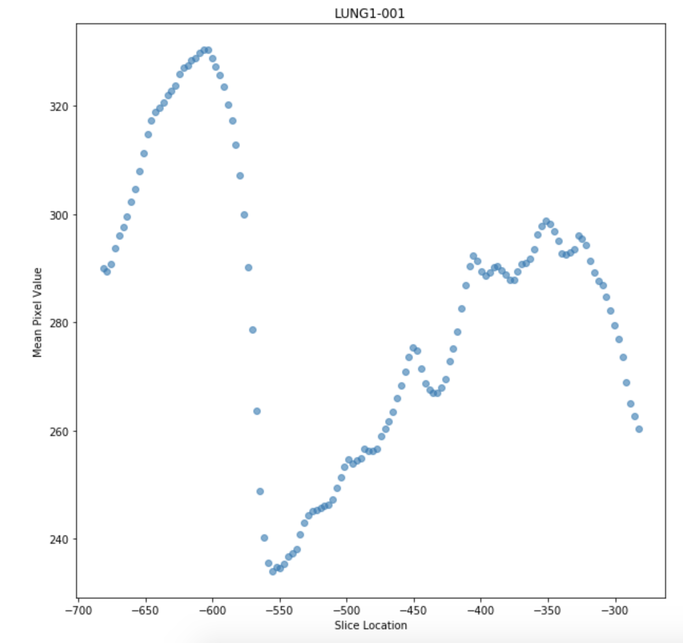
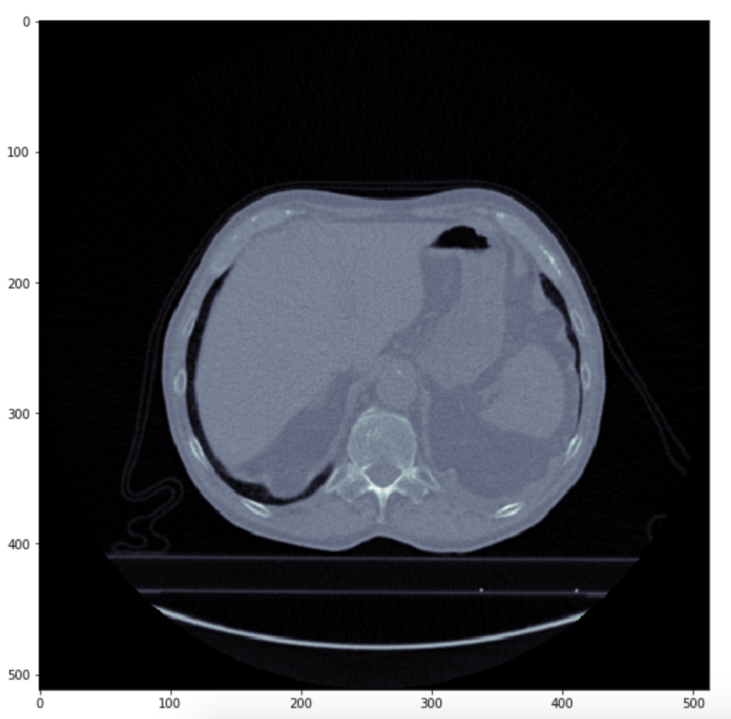
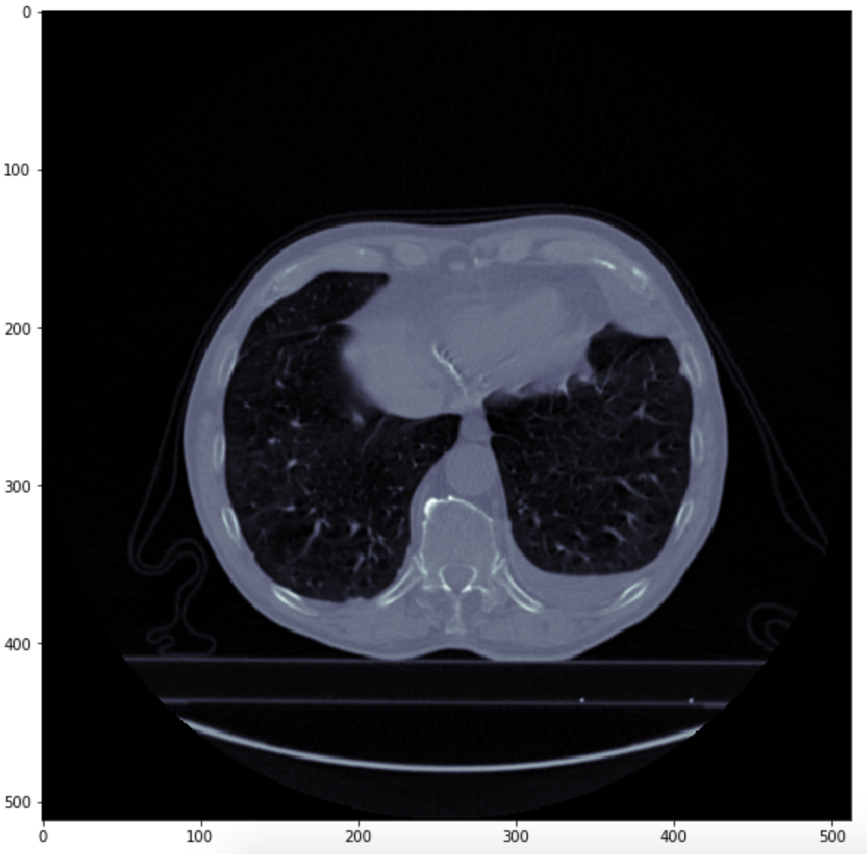

Slide 7
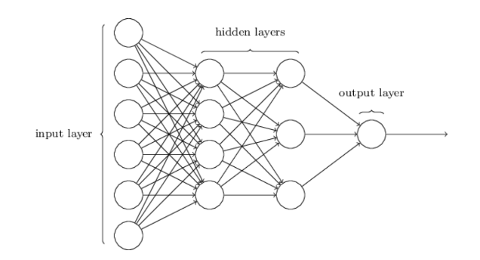
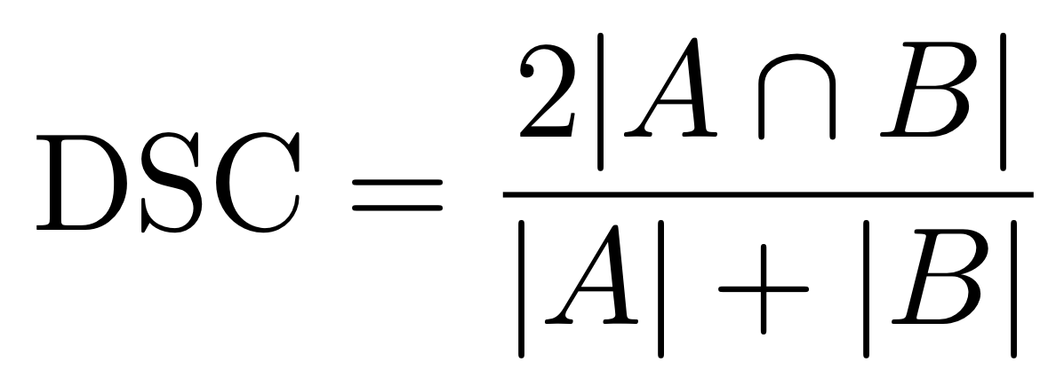
Machine Learning
Set of algorithms which give a computer the ability to learn from experiences through completing tasks without being explicitly programmed to complete the tasks [2].
Neural network achieves this by iteratively altering weights of nodes in order to minimise a cost function, in this case 1 - Dice-Sorensen coefficient, DSC.
61 slices in training set, 5 in validation set and 6 in test set.
[2]

Slide 8

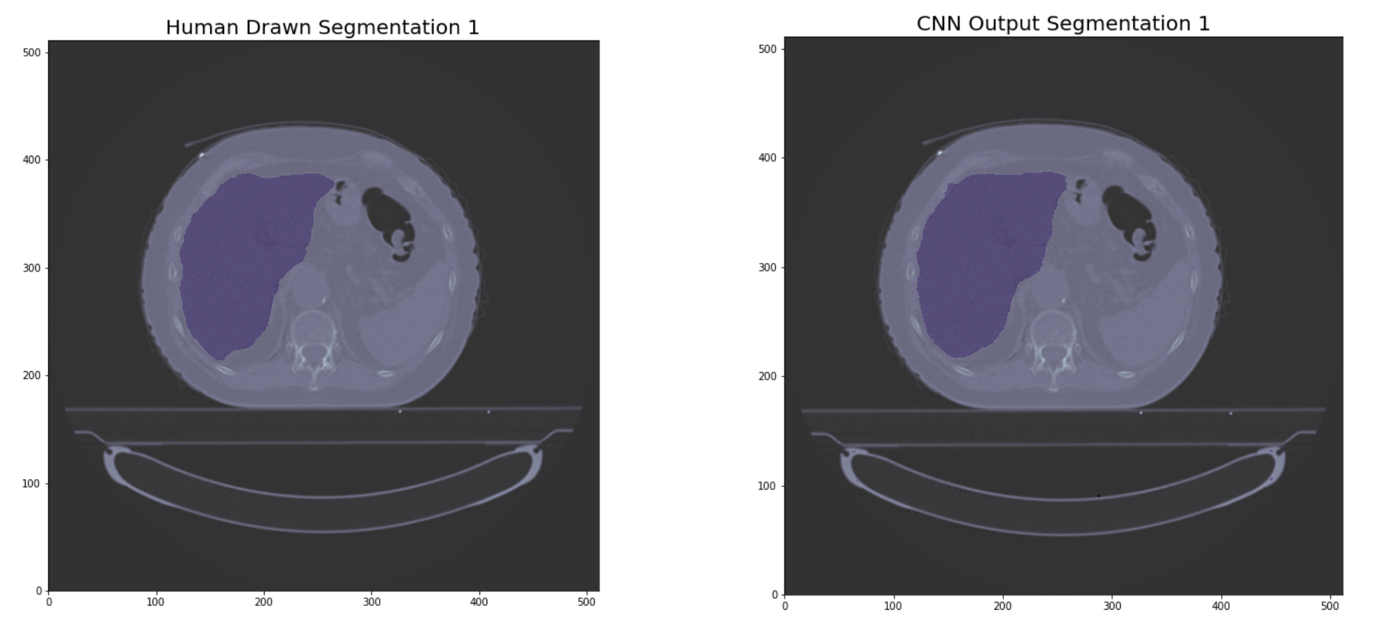
Machine Learning cont’d.
Script provided by Dr Andrew Green at the University of Manchester for a transfer learning CNN for image segmentation through the addition of transpose convolutional and skip layers [4].
Trained for 45 epochs, DSC loss (1-DSC) of
Very effective CNN.

Slide 9
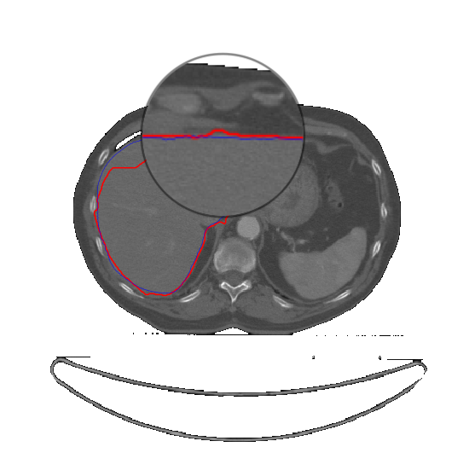
Calculating the LSN score
Using the mask output from the CNN, a line for the supposed healthy liver surface was drawn (the blue line).
An active contour algorithm on the original CT image was used to find a line for the true boundary of the liver (the red line).
By calculating the distance between each point of the lines and taking the average gives the LSN score. Higher values indicate a rougher surface and a liver that is more likely to be cirrhotic [5].

Slide 10
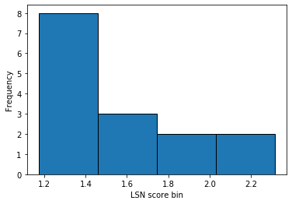
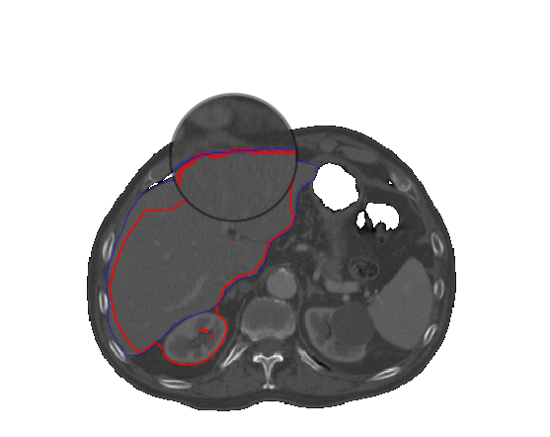
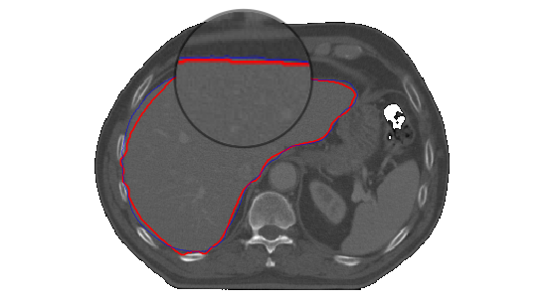
LSN = 2.20 ± 0.32
LSN = 1.29 ± 0.27

Slide 11
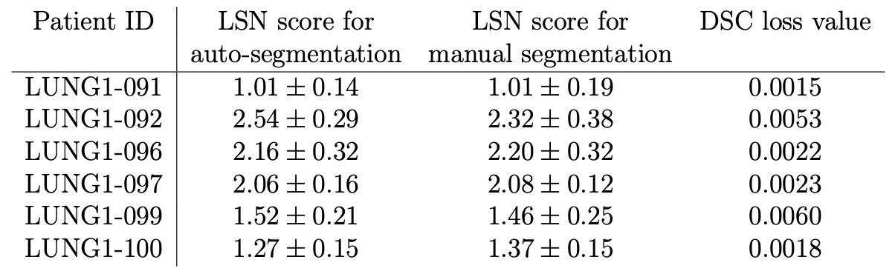
Manual vs Automatic Segmentation
LSN scores for auto and manual segmentation show no significant difference.

Slide 12
Conclusions
What has been achieved
The liver was found from a full CT scan using the methods described.
An algorithmic method of evaluating the liver using an LSN score was developed.
Comparing the LSN results for manual segmentation and automatic segmentation using machine learning gave very similar results. It is therefore justified to use machine learning as a segmentation method.
Future work needed
The LSN score determination still requires human input to select the region of interest which needs work before it can be full automated.
Analysis of livers with known levels of cirrhosis must be carried out to determine threshold LSN scores.
Large cohorts of patients’ data needs to be analysed to see if there is a connection between liver health and the outcome of treatment in lung cancer patients.

Slide 13
References
https://www.gastroconsa.com/patient-education/liver-cirrhosis/
E. Alpaydin, Introduction to Machine Learning. The MIT Press, 2010.
F. Chollet, Deep Learning with Python, 1st ed. USA: Manning Publications Co., 2017.
A. Green, M. van Herk, and A. McWilliam, “Transfer learning for sarcopenia segmentation,” 2020.
A. D. Smith, C. R. Branch, K. Zand, C. Subramony, H. Zhang, K. Thaggard, R. Hosch, J. Bryan, A. Vasanji, M. Griswold, and X. Zhang, Liver surface nodularity quantification from routine CT images as a biomarker for detection and evaluation of cirrhosis," Radiology, vol. 280, no. 3, pp. 771 {781, 2020/04/20 2016. [Online]. Available: https://doi.org/10.1148/radiol.2016151542

